Slide 1
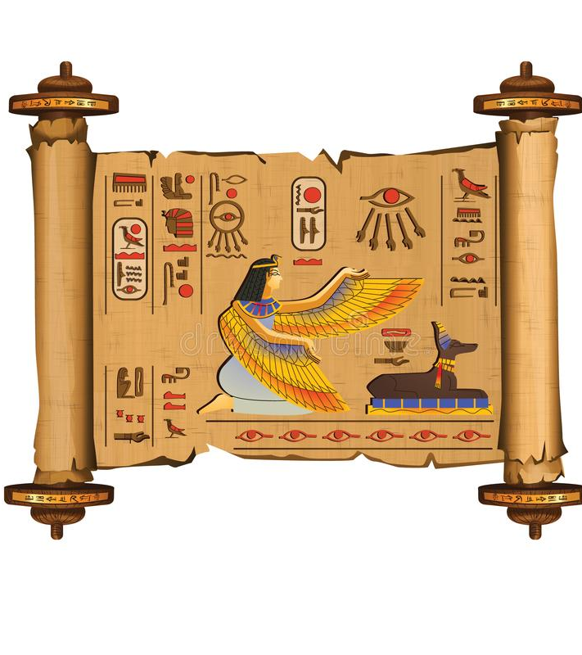
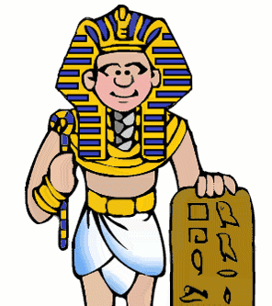
Papyrus

Slide 2
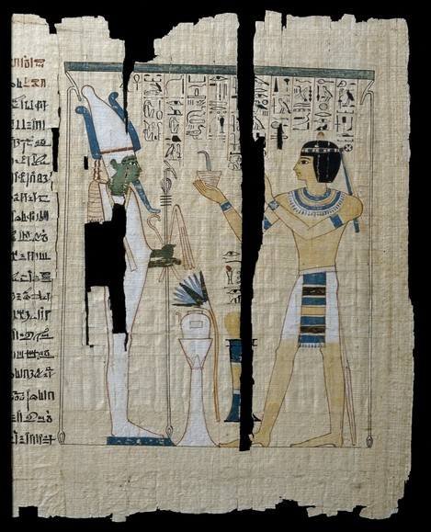
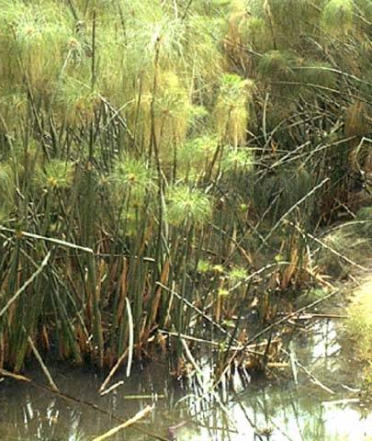
Papyrus
Papyrus was very important to Ancient Egyptians.
Papyrus is made from pressed reeds and can get damaged over time.
It was used for everyday writing, but also for documents which were put in the tomb with the dead. The Egyptians wrote on papyrus with a pen.
Museums used to cut the rolls of papyrus into sheets for easier storage and display.

Slide 3
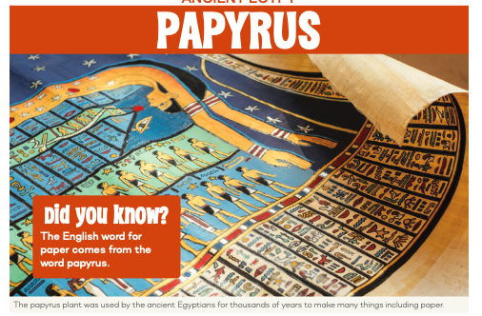
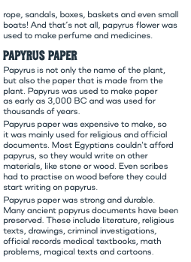
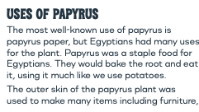

Slide 4
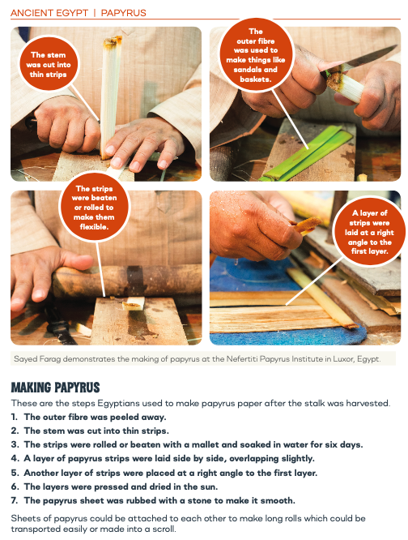
Watch how papyrus is made: https://www.youtube.com/watch?v=DCR8n7qS43w

