Slide 1
Volume
N
- MATHS TOPICS KS2 -

Slide 2
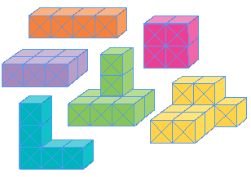
Volume
What is Volume?
Volume is a measure of how much SPACE an object takes up.
Watch this video on volume:
https://www.bbc.co.uk/bitesize/topics/zjbg87h/articles/zcrxtyc
N
Capacity

Slide 3
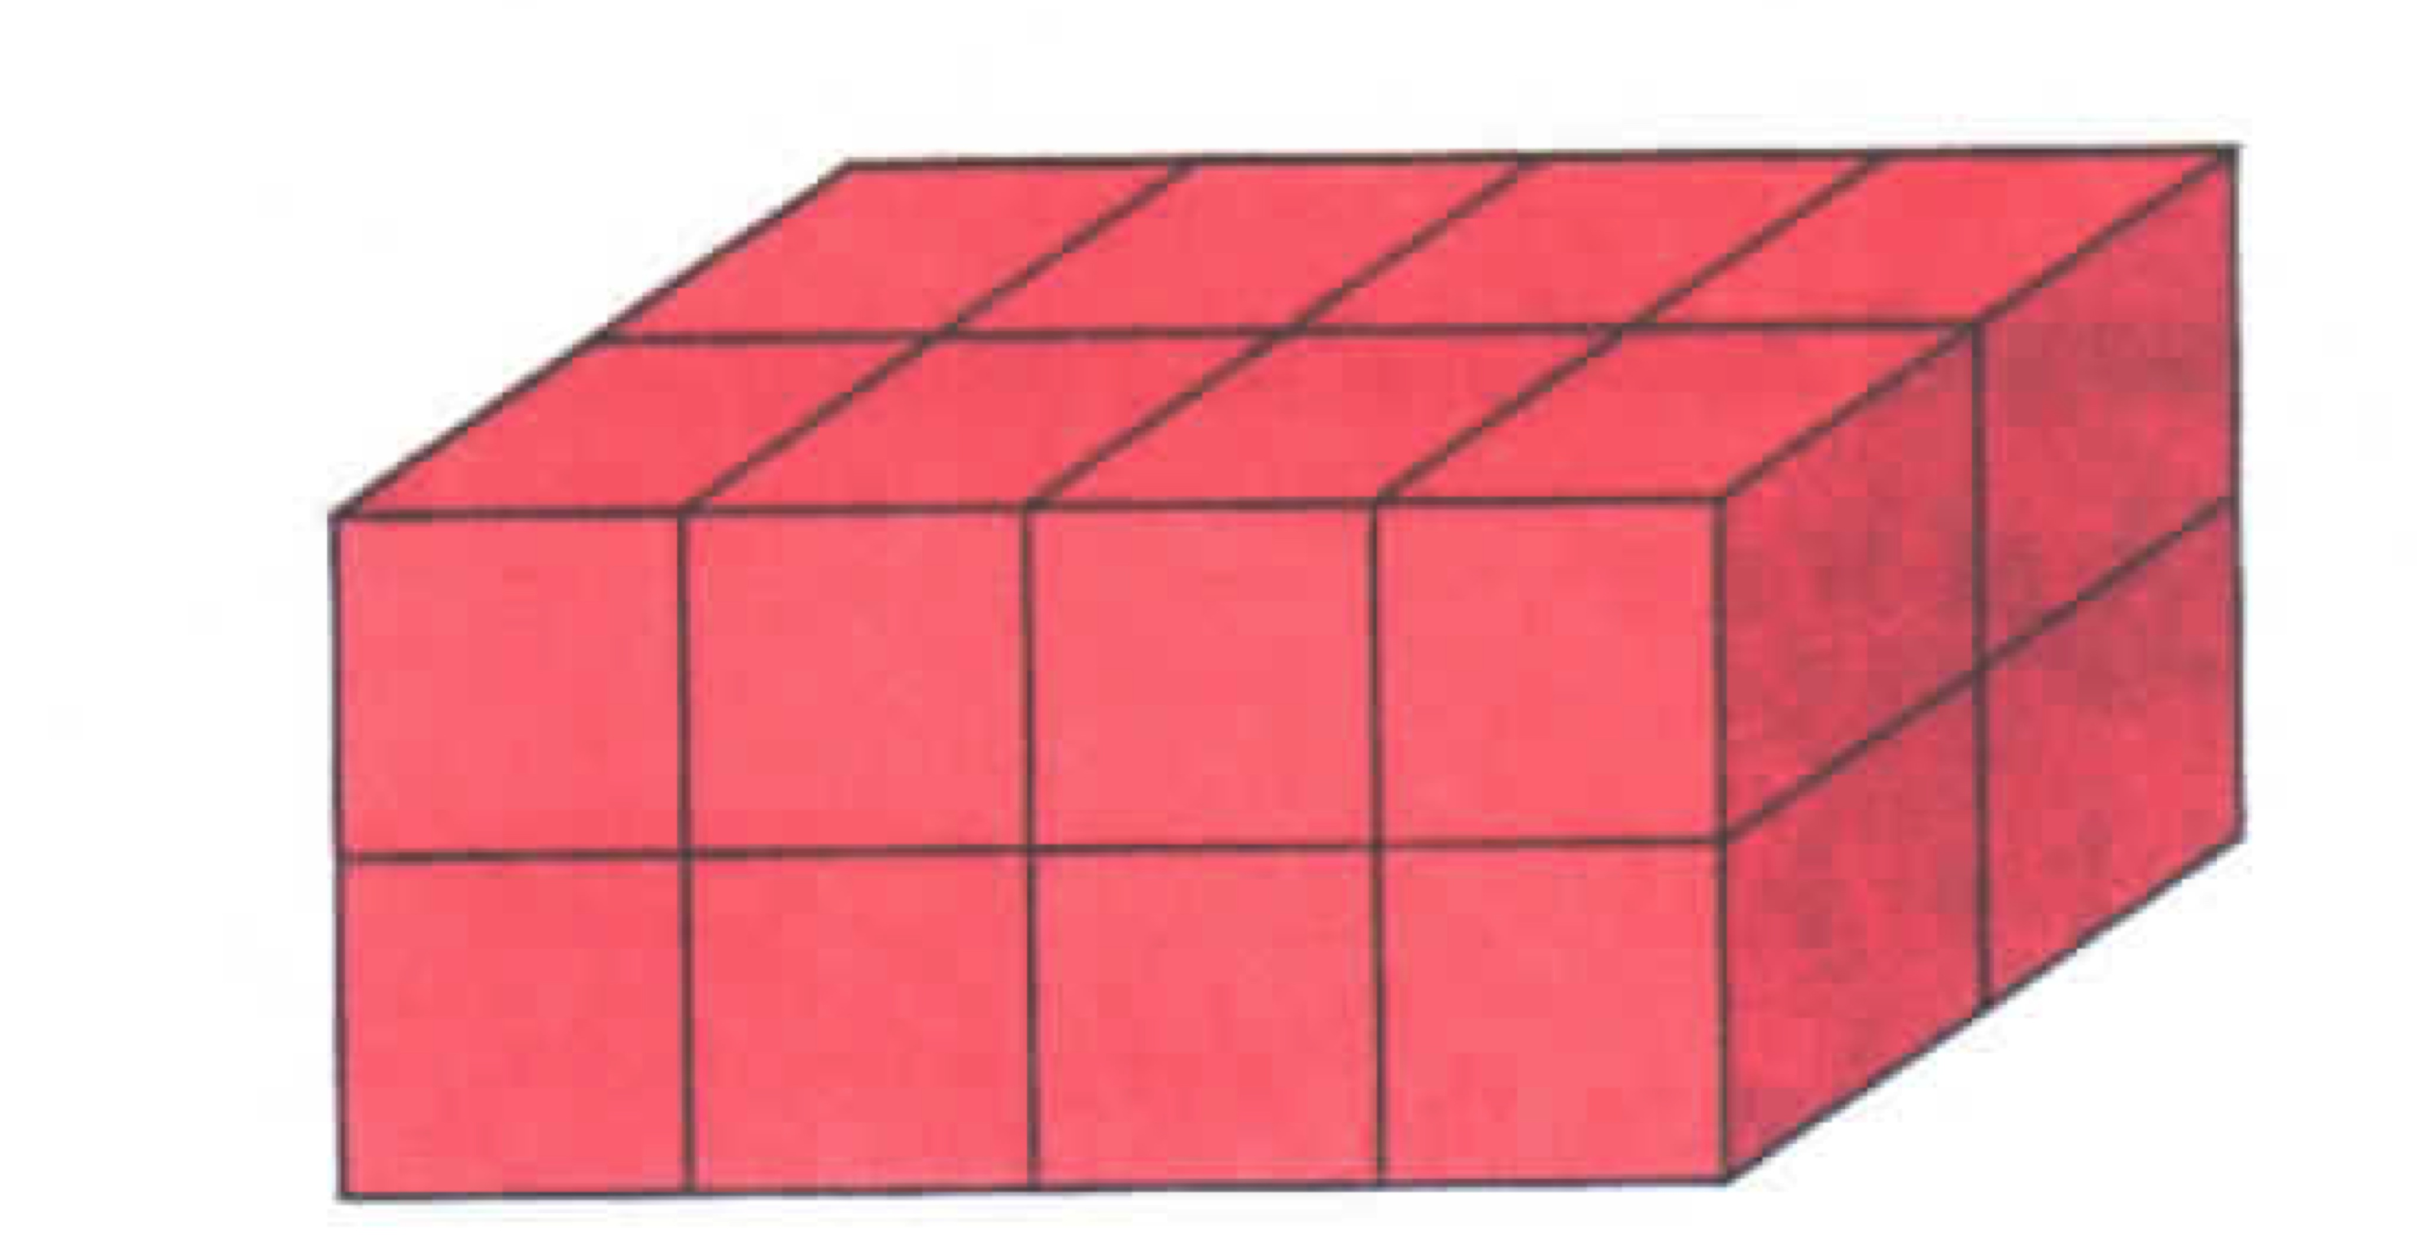
Volume
Units
Volume is measured in centimetres cubed (cm³) or metres cubed (m³) .
Reminder:
100cm³ = 1m³
N
Volume

Slide 4
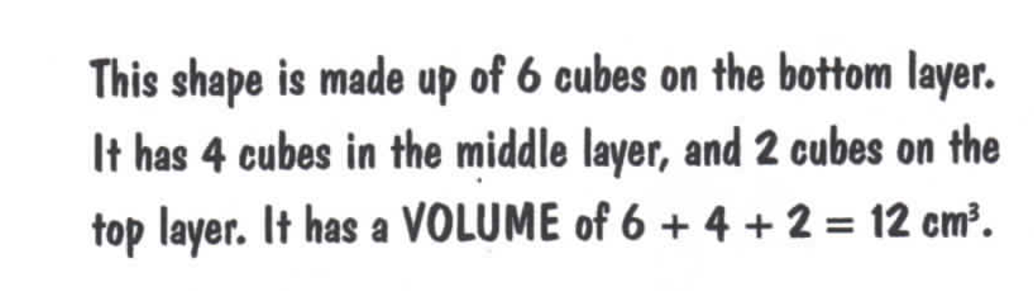
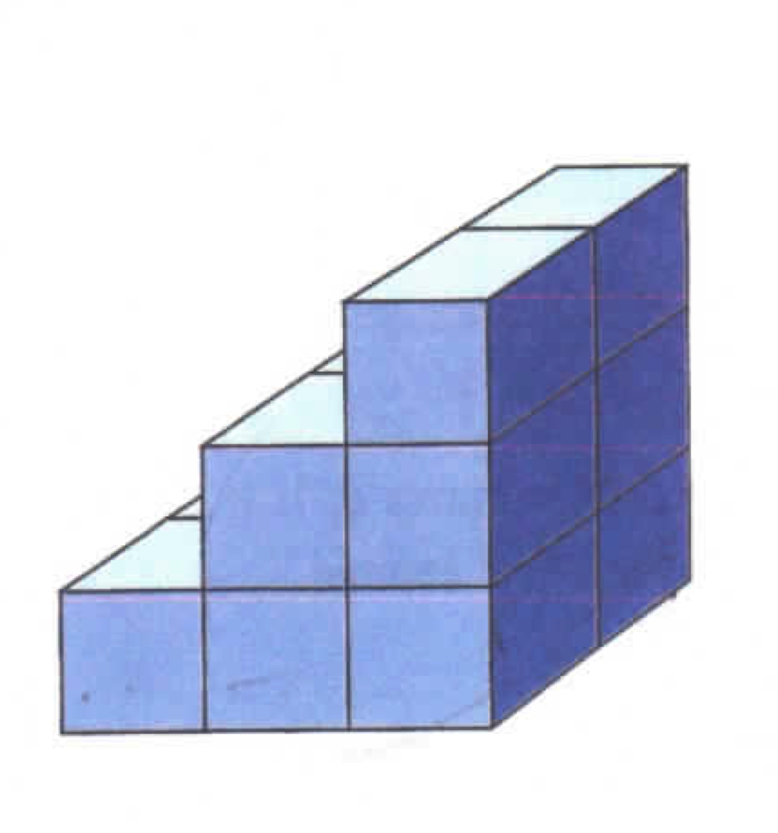
Volume
Calculating Volume of more complex shapes:
N
Volume

Slide 5
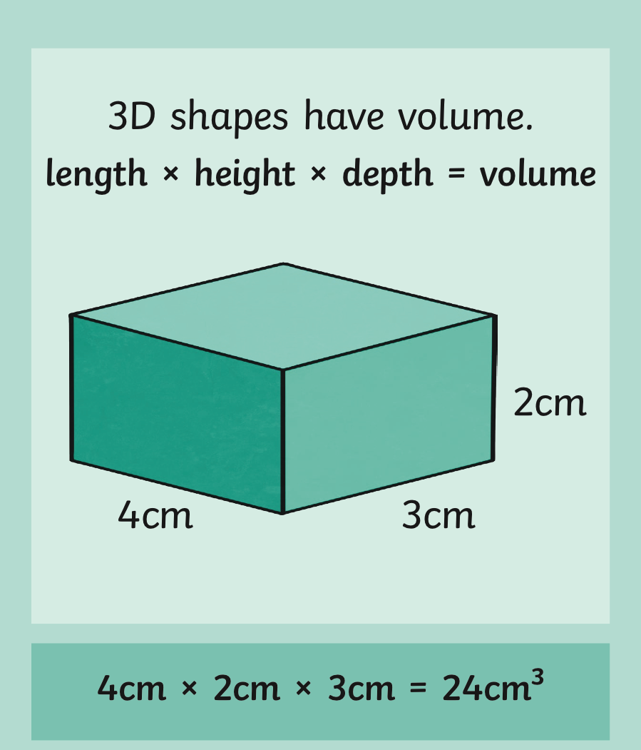
Volume
N
Volume

Slide 6
Volume
Calculating Volume:
Volume = length x width x height
Volume = 4 x 4 x 4 = 64cm³
4cm
1cm
4cm
4cm
1cm
1cm
N
Volume

Slide 7

Which volume is the correct measurement?
2x2x4
20 cubic units
Incorrect! Try again.
16 cubic units
Correct! Well done.
15 cubic units
Incorrect! Try again.
Next question

Slide 8
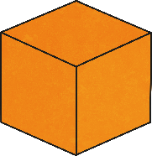
Which volume is the correct measurement?
3x2x5
6 cubic units
Incorrect! Try again.
29 cubic units
Incorrect! Try again.
30 cubic units
Correct! Well done.
Next question

Slide 9
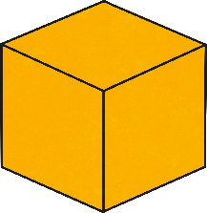
Which volume is the correct measurement?
2x4x2
20 cubic units
Incorrect! Try again.
16 cubic units
Correct! Well done.
15 cubic units
Incorrect! Try again.
Next question

Slide 10
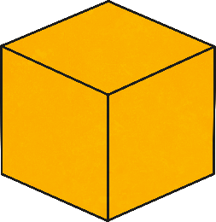
Which volume is the correct measurement?
2x3x3
10 cubic units
Incorrect! Try again.
18 cubic units
Correct! Well done.
20 cubic units
Incorrect! Try again.
Next question

Slide 11
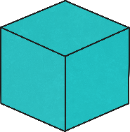
Which volume is the correct measurement?
4x4x4
12 cubic units
Incorrect! Try again.
16 cubic units
Incorrect! Try again.
64 cubic units
Correct! Well done.
Next question

Slide 12
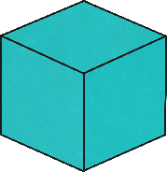
Which volume is the correct measurement?
3x3x3
27 cubic units
Correct! Well done.
30 cubic units
Incorrect! Try again.
9 cubic units
Incorrect! Try again.

