Slide 1
Capacity
N
- MATHS TOPICS KS2 -

Slide 2
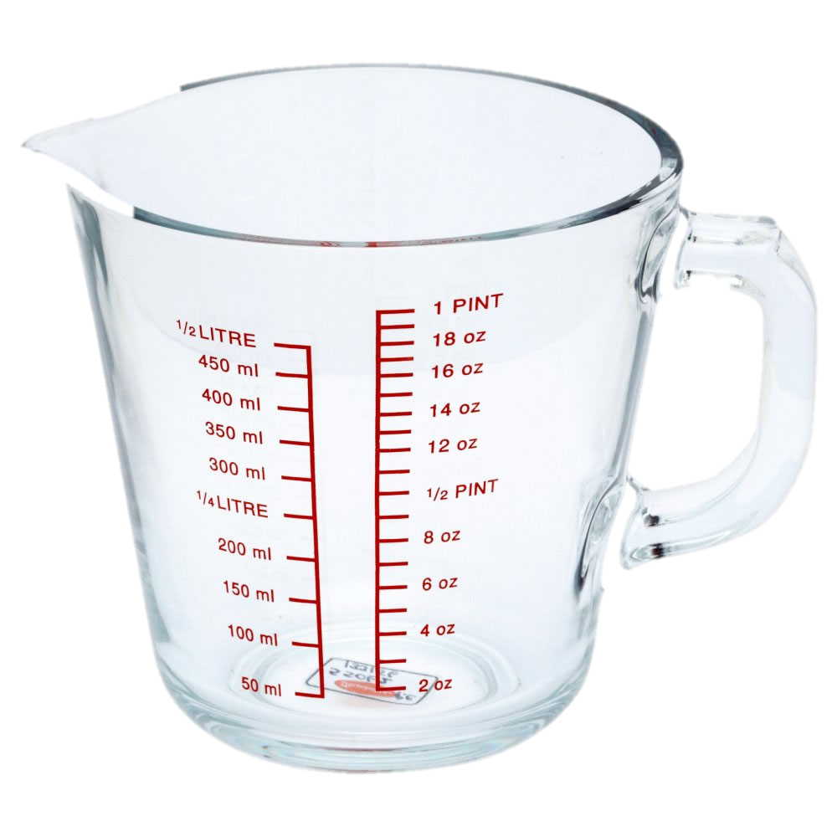
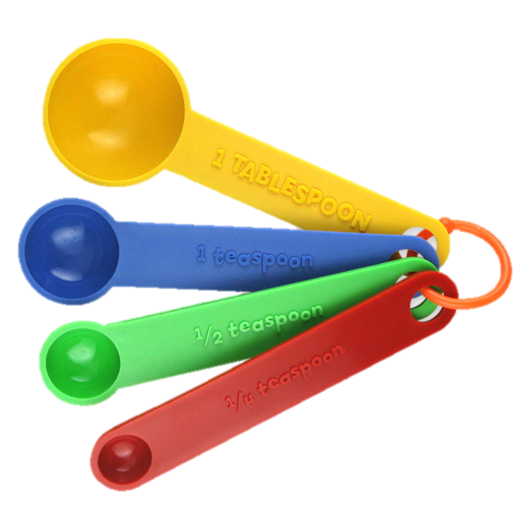
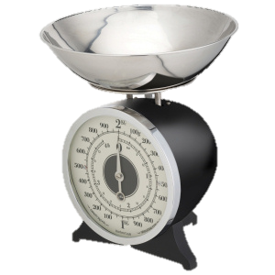
Capacity
What is Capacity?
Capacity is the amount that a container can hold.
Capacity measures the amount of space inside something.
Watch this video on capacity:
https://www.bbc.co.uk/bitesize/topics/zt9k7ty/articles/zp8crdm
N
Capacity

Slide 3
Capacity
Watch this video to learn more about capacity:
https://www.bbc.co.uk/teach/class-clips-video/maths-ks2-capacity-and-measure/z7gkqp3
N
Capacity

Slide 4
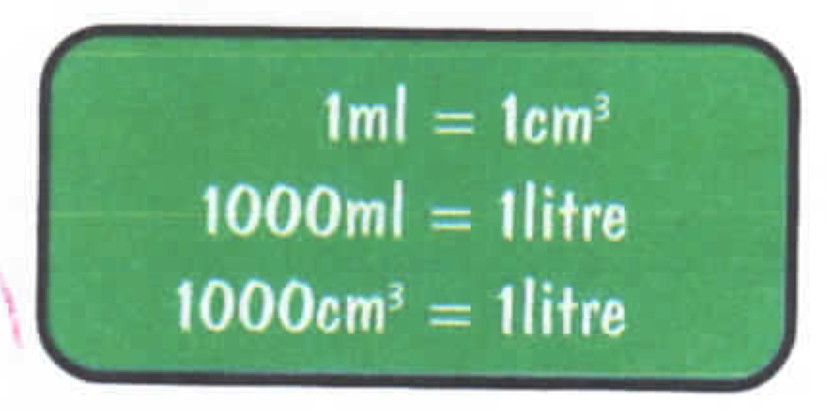
Capacity
Units
Capacity is measured in millilitres (mls), litres (L) or cm^{3.}
How many mls are in 1L?
1ml = 1cm³
N
Capacity

Slide 5
Capacity
Units
How many mls will there in ½ L?
500 mls
1000 ÷ 2 =
250 mls
How many mls will there be in ¼L?
1000 ÷ 4 =
How many mls will there be in ¾ L?
750 mls
1000 ÷ 4 X 3 =
N
Capacity

Slide 6
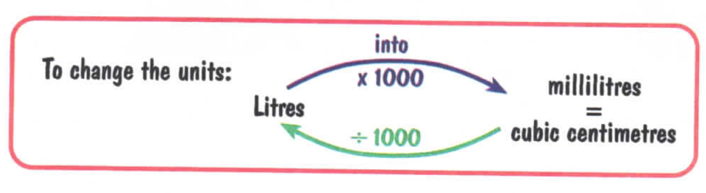
Capacity
Units:
To convert from ml to L, we divide by 1000.
There are 1000 mls in 1 L.
To convert from L to ml, we multiply by 1000.
N
Capacity

Slide 7
Capacity
Units:
Your turn:
How many ml in 3 L?
How many L in 6500 ml?
How many ml in 2 ¼ L?
3000 ml
6 ½ L
2250 ml
N
Capacity

Slide 8
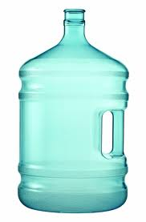
Capacity
Comparing Units:
6L
6000ml
N
Capacity

Slide 9
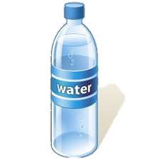
Capacity
Comparing Units:
1.5L
1500ml
N
Capacity

Slide 10
Capacity
How many small bottles would it take to fill a tank?
1L
6000ml
N
Capacity

Slide 11
Capacity
How many small bottles would it take to fill a tank?
6000ml
N
Capacity

Slide 12

Capacity
Attention:
P6 continue beyond this point!
P5
N
Capacity

Slide 13
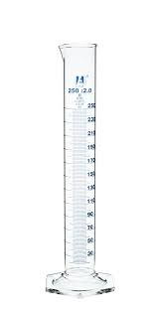
Capacity
Measuring Capacity.
Capacity can be measured in a measuring cylinder or jug.
Practise reading capacity on the following slides.
Measuring jug
Measuring cylinder
N
Capacity

Slide 14
Reading Scale (1)
ml
What fraction of a litre is shown each time?
Write your answer down with a partner.
1000
900
3
10
800
l
700
600
✓
500
400
300
200
100

Slide 15
Reading Scale (1)
ml
1000
900
7
10
800
l
700
600
✓
500
400
300
200
100

Slide 16
Reading Scale (1)
ml
1000
900
1
2
800
l
700
600
✓
500
400
300
200
100

Slide 17
Reading Scale (1)
ml
1000
900
1
10
800
l
700
600
✓
500
400
300
200
100

Slide 18
Reading Scale (1)
ml
1000
900
9
10
800
l
700
600
✓
500
400
300
200
100

Slide 19
Reading Scale (1)
ml
1000
900
1
4
800
l
700
600
✓
500
400
300
200
100

Slide 20
Reading Scale (1)
ml
1000
900
3
4
800
l
700
600
✓
500
400
300
200
100

Slide 21
Reading Scale (1)
ml
1000
900
1
5
800
l
700
600
✓
500
400
300
200
100

Slide 22
Reading Scale (1)
ml
1000
900
4
5
800
l
700
600
✓
500
400
300
200
100

Slide 23
Reading Scale (1)
ml
For this scale count from 100ml to 200ml.
When working out the scale, you need to count the number of jumps between two numbers.
500
400
300
ANSWER – 2 Jumps
200
2
1
100

Slide 24
Reading Scale (1)
How many jumps between numbers?
Write your answer with a partner.
ml
500
400
300
ANSWER – 4 Jumps
200
100

Slide 25
Reading Scale (1)
How many jumps between numbers?
Write your answer with a partner.
ml
700
600
500
ANSWER – 5 Jumps
400
300

Slide 26
Reading Scale (1)
How many jumps between numbers?
Write your answer with a partner.
ml
500
ANSWER – 10 Jumps
400

Slide 27
Reading Scale (1)
How many jumps between numbers?
Write your answer with a partner.
ml
900
800
700
ANSWER – 4 Jumps
600
500

Slide 28
Reading Scale (1)
How many jumps between numbers?
Write your answer with a partner.
ml
200
ANSWER – 10 Jumps
100

