Slide 1

Mental Addition
N
- MATHS TOPICS KS2 -

Slide 2
Addition
What is mental addition?
https://www.bbc.co.uk/bitesize/topics/zy2mn39/articles/zyhdfcw Watch this video!
Mental addition involves adding numbers together in your head, without using a written method.
There are a range of mental addition strategies to choose from.
Can you think of any?
N
Addition

Slide 3
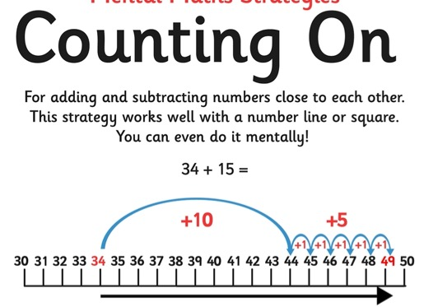
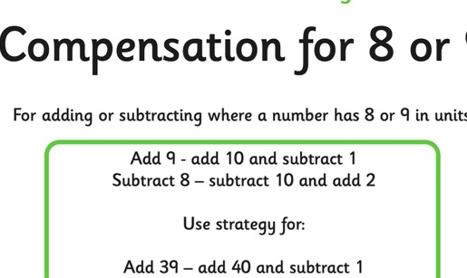
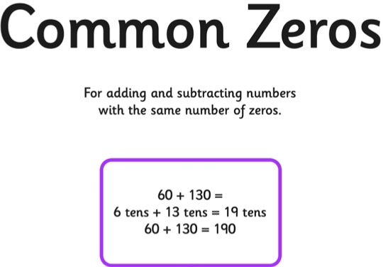
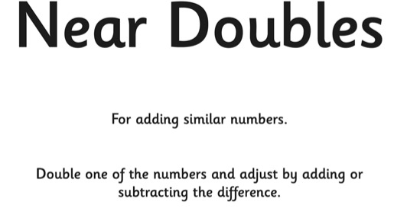
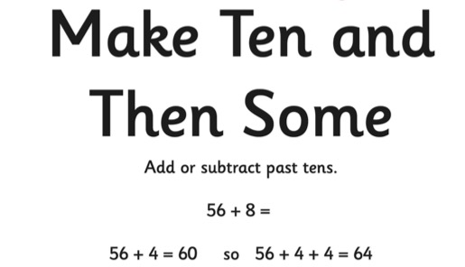
Addition
Strategies
N
Addition

Slide 4
Addition
How would you work out this sum?
Adding multiples of 10
518 + 40 =
558
+10
+10
+10
+10
518
528
538
548
558
N
Addition

Slide 5
Addition
How would you work out this sum?
Adding multiples of 10
510 + 60 =
570
+10
+10
+10
+10
+10
+10
510
520
530
540
550
560
570
N
Addition

Slide 6
Addition
How would you work out this sum?
Adding multiples of 10
510 + 60 =
570
+60
510
570
N
Addition

Slide 7
Addition
How would you work out this sum?
469 + 60 =
529
+10
+10
+10
+10
+10
+10
469
479
489
499
509
519
529
N
Addition

Slide 8
Addition
How would you work out this sum?
Adding near multiples of 10
22 + 19 =
41
+20
-1
22
41
42
N
Addition

Slide 9
Addition
How would you work out this sum?
334 + 58 =
392
+60
-2
334
392
394
N
Addition

Slide 10


Addition
Doubles
Let’s double 26.
We can partition 26 into 10s and 1s. and double each part.
Double 26
Double 20 is ?
40
12
40 + 12 = 52
Double 6 is ?
40 + 12 = ?
Now choose three more 2-digt numbers and double them.
Can you find one that totals more than 100?
N
Addition

Slide 11
Addition
10
20
20
40
30
60
Let’s check through some of our doubles.
40
80
50
100
60
120
70
140
80
160
90
180
100
200
Addition

Slide 12
Addition
Doubles
Let’s try 75.
Double 75
Double 70 is ?
140
10
Double 5 is ?
140 + 10 = 150
Double 75 is ?
Now 84.
Double 84
Double 80 is ?
160
8
Double 4 is ?
160 + 8 = 168
Double 84 is ?
Addition

Slide 13
Addition
100
200
Let’s check through the doubles of 100s numbers.
200
400
300
600
400
800
500
1000
Do you see a pattern here?
600
1200
700
1400
800
1600
900
1800
1000
2000
Addition

Slide 14
Addition
How would you work out this sum?
230 + 230 =
460
Double 23 = 46
Double 230 = 460
N
Addition

Slide 15
Addition
How would you work out this sum?
230 + 240 =
470
Double 23 = 46
Double 230 = 460
460 + 10 = 470
N
Addition

Slide 16
Addition
How would you work out this sum?
420 + 430 =
850
Double 42 = 84
Double 420 = 840
840 + 10 = 850
N
Addition

Slide 17
Thanks for listening
N
- MATHS TOPICS KS2 -

