Slide 1
Interpreting Data
(Mean, Mode, Median & Range)
N
- MATHS TOPICS KS2 -
Miss S P5/6

Slide 2
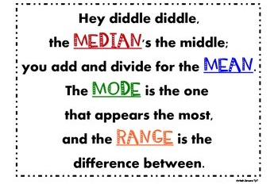
Data
Do you remember this rhyme?
Watch this video on interpreting data :
https://www.bbc.co.uk/bitesize/topics/zm49q6f/articles/z99jpbk
N
Data

Slide 3
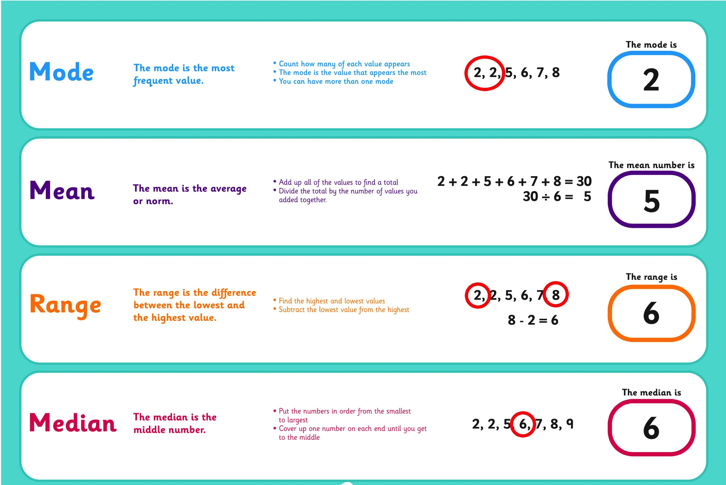
Data
Mean, Mode, Median & Range:
N
Data

Slide 4
The Mode
The mode is the most frequent value
(it appears the most)
Count how many of each value appears
The mode is the value that appears the most
*You can have more than one mode*

Slide 5
The Mean
The mean is the average.
To find the mean, add up all of the values to find a total.
Divide the total by the number of values you have added together
2 + 2 + 5 + 6 + 7 + 8 = 30
30 ÷ 6 = 5
The mean is 5

Slide 6
The Mean
The mean is the average
To find the mean, add up all of the values to find a total.
Divide the total by the number of values you have added together
Work out the mean of these numbers
11, 12, 10
10 + 11 + 12 = 33
33 ÷ 3 = 11
The mean is 11
(Count them to check you have the same amount of numbers)

Slide 7
The Mean
The mean is the average
To find the mean, add up all of the values to find a total.
Divide the total by the number of values you have added together
Work out the mean of these numbers
10, 20, 15, 5
5 + 10 + 15 + 20 = 50
50 ÷ 4 = 12.5
The mean is 12.5
(Count them to check you have the same amount of numbers)

Slide 8
The Mode
The mode is the most frequent value
(it appears the most)
The mode is the value that appears the most
It helps if you order the values from smallest to largest.
2, 3, 4, 1, 2, 3, 5, 6, 3, 1
(order them from smallest to largest)
1, 1, 2, 2, 3, 3, 3, 4, 5, 6
(Count them to check you have the same amount of numbers)
3 is the mode because it appears the most

Slide 9
You can have more than one mode
The mode is the most frequent value
(it appears the most)
1, 3, 3, 3, 5, 6, 6, 9, 9, 9
There are two modes here 3 and 9

Slide 10
The Mode
The mode is the most frequent value
(it appears the most)
The mode is the value that appears the most
Work out the mode of these numbers
*It helps if you order the values from smallest to largest.*
1, 5, 6, 4, 3, 5, 3, 5, 6, 2, 10
(order them from smallest to largest)
1, 2, 3, 3, 4, 5, 5, 5, 6, 6, 10
(Count them to check you have the same amount of numbers)
5 is the mode because it appears the most

Slide 11
The Mode
The mode is the most frequent value
(it appears the most)
The mode is the value that appears the most
Work out the mode of these numbers
*It helps if you order the values from smallest to largest.*
11, 23, 22, 14, 23, 10, 11, 16, 19
(order them from smallest to largest)
10, 11, 11, 14, 16, 19, 22, 23, 23
(Count them to check you have the same amount of numbers)
11 and 23 are the two modes because they appear the most

Slide 12
The Mode
The mode is the most frequent value
(it appears the most)
The mode is the value that appears the most
Work out the mode of these numbers
*It helps if you order the values from smallest to largest.*
11, 23, 22, 14, 10, 12, 16, 19
(order them from smallest to largest)
10, 11, 12, 14, 16, 19, 22, 23
(Count them to check you have the same amount of numbers)
There is NO mode in this set of data!

Slide 13
The Median
The median is the middle number.
Put the numbers in order from the smallest to the largest.
Cover up one number on each end until you get to the middle.
2, 2, 5, 6, 7, 8, 9

Slide 14
The Median
The median is the middle number.
The median is the value that appears in the middle…
It helps if you order the values from smallest to largest.
2, 3, 4, 1, 2, 3, 5, 6, 3, 3, 1
(order them from smallest to largest and cross them out until you reach the middle)
1, 1, 2, 2, 3, 3, 3, 3, 4, 5, 6
(Count them to check you have the same amount of numbers)
3 is the median because it appears in the middle

Slide 15
The Median
The median is the middle value
(it appears in the middle)
The median is the value that appears in the middle
Work out the median of these numbers
*It helps if you order the values from smallest to largest.*
11, 23, 22, 14, 23, 10, 11, 16, 19
(order them from smallest to largest)
10, 11, 11, 14, 16, 19, 22, 23, 23
(Count them to check you have the same amount of numbers)
16 is the median because it appears the middle

Slide 16
The Median
The median is the middle value
(it appears in the middle)
The median is the value that appears in the middle
Work out the median of these numbers
*It helps if you order the values from smallest to largest.*
11, 23, 22, 14, 23, 14, 10, 11, 16, 19
(order them from smallest to largest)
10, 11, 11, 14, 14, 16, 19, 22, 23, 23
(Count them to check you have the same amount of numbers)
The middle of this sequence is in-between 14 and 16 = 15
15 is the median

Slide 17
The Median
The median is the middle value
(it appears in the middle)
The median is the value that appears in the middle
Work out the median of these numbers
*It helps if you order the values from smallest to largest.*
23, 34, 22, 24, 43, 34, 23, 34, 22, 13
(order them from smallest to largest)
13, 22, 22, 23, 23, 24, 34, 34, 34, 43
(Count them to check you have the same amount of numbers)
The middle of this sequence is in-between
23 and 24 = 23.5
23.5 is the median

Slide 18
The Range
The range is the difference between the lowest and the highest value.
Find the highest and lowest values
Subtract the lowest value from the highest
2, 2, 5, 6, 7, 8, 9
9 – 2 = 7
Range = 7

Slide 19
The Range
The range is the difference between the lowest and the highest value.
The range is the highest - lowest
Work out the range of these numbers
*It helps if you order the values from smallest to largest.*
11, 23, 22, 14, 23, 10, 11, 16, 19
(order them from smallest to largest)
10, 11, 11, 14, 16, 19, 22, 23, 23
(Count them to check you have the same amount of numbers)
23 – 10 = 13
The range is 13

Slide 20
The Range
The range is the difference between the lowest and the highest value.
The range is the highest - lowest
Work out the range of these numbers
*It helps if you order the values from smallest to largest.*
20, 32, 45, 23, 24, 54, 23, 50, 60
(order them from smallest to largest)
20, 23, 23, 24, 32, 45, 50, 54, 60
(Count them to check you have the same amount of numbers)
60 – 20 = 40
The range is 40

