Slide 1
Negative Numbers
N
- MATHS TOPICS KS2 -
Miss S P5/6

Slide 2
Negative Numbers
What are negative numbers?
We think of numbers being on a number line:
0
1
2
3
4
5
6
7
8
9
10
∞
These numbers are all positive numbers, although we don’t actually put the + sign in front of each number
+
N
Negative Numbers

Slide 3
Negative Numbers
What are negative numbers?
The number line can also continue on past 0:
-9
-8
-7
-6
-5
-4
-3
-2
-1
0
1
2
3
4
5
6
7
8
9
10
These new numbers are negative numbers.
-
N
Negative Numbers

Slide 4
Negative Numbers
What are negative numbers?
Numbers don't just stop at zero. When you count backwards from zero, you go into negative numbers.
Zero, 0, is neither positive nor negative.
Watch these videos on Negative Numbers:
https://www.youtube.com/watch?v=6U1kCOuNpR4
https://www.bbc.co.uk/bitesize/topics/znwj6sg/articles/zxthnbk
https://www.bbc.co.uk/bitesize/clips/zcr9jxs
N
Negative Numbers

Slide 5
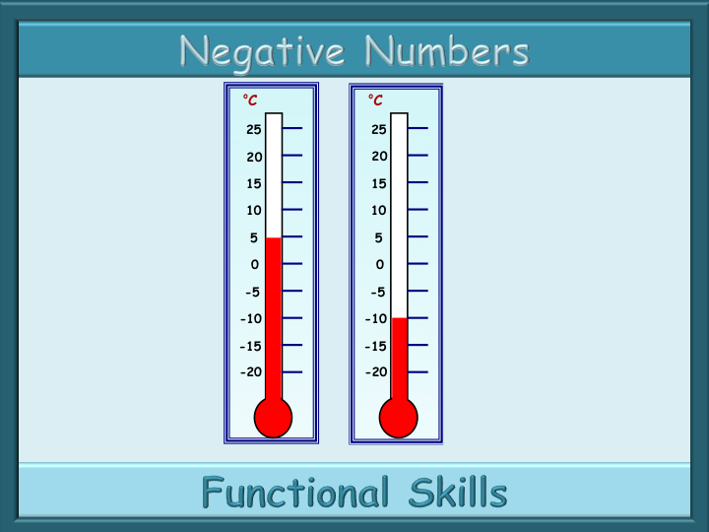
Negative Numbers
What are negative numbers?
The temperature
scale is often seen vertically.
Getting warmer
0ºC = water freezing
Water freezing
As the temperature goes below freezing we use negative numbers.
Getting colder
N
Negative Numbers

Slide 6
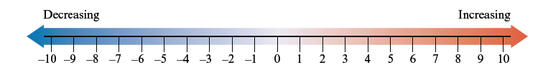
Negative Numbers
What are negative numbers?
A number line can help us with negative numbers
Can you complete the following sequences?
Use the number line to help.
10, , 4, , -2,
7
1
-9, , -1, , 7,
-5
3
11
N
Negative Numbers

Slide 7
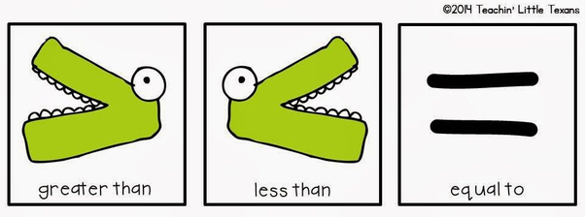
Negative Numbers
What are negative numbers?
You can use this number line to help you when working with negative numbers.
N
Negative Numbers

