Slide 2

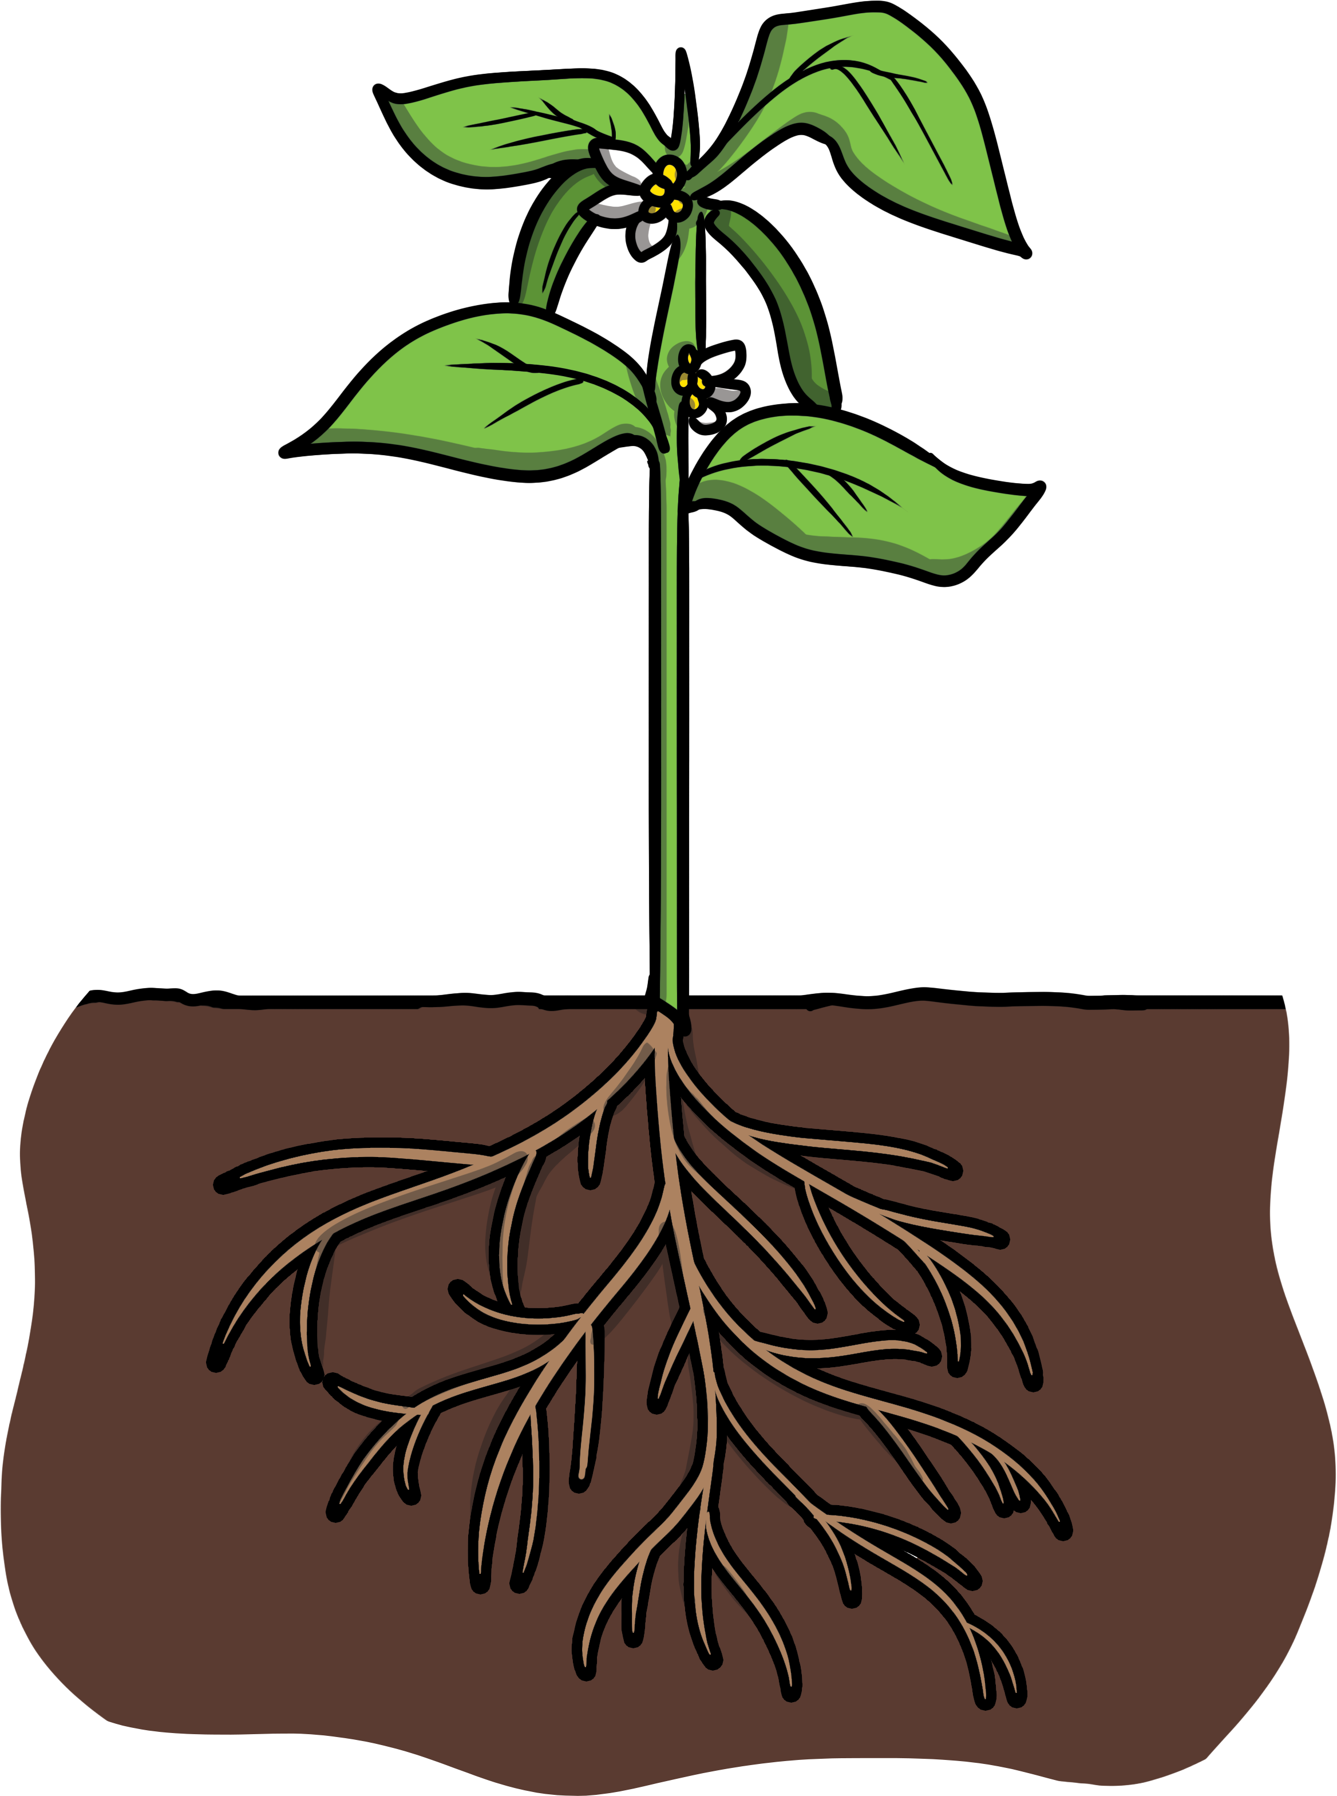
Suffixes: ful
What is a suffix?
A suffix is a sound or group of letters that attach to the end of a root word, for example, ‘-ful’ or ‘ness’

Slide 3
Suffixes: ful
Can you remember what a root word is?
A root word is a basic word, from which other words are made, when prefixes and suffixes are added.

Slide 4
Suffixes: ful
What does a suffix do?
A suffix changes the meaning of the root word.

Slide 5
Suffixes: ful
Here are some questions to think about.
Think of words that end with -ful or -ness ?
Are you able to discover what the root word is?
How does the -ful or -ness change the meaning of the word?

Slide 6



Suffixes: ful
“A suffix is a bit more complicated than a prefix. A suffix is so important to the root word, that it actually changes it from a verb, to an adjective!”

Slide 7
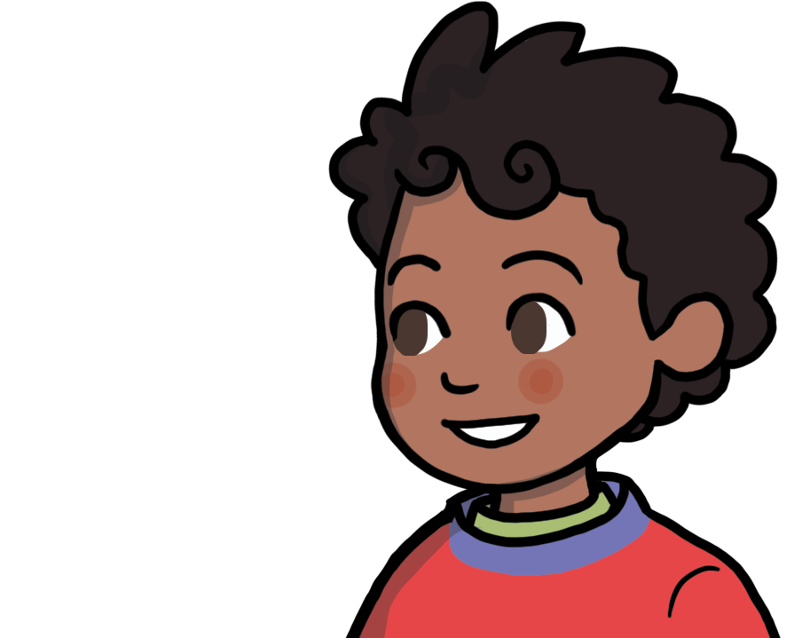
Suffixes: ful
“So take the word PLAY. Play is a verb, a doing word. Now, add ‘-ful’ to play, and you get the word playful”
“Oh! I understand! So Tiggy plays with Gogo’s wool.”

Slide 8
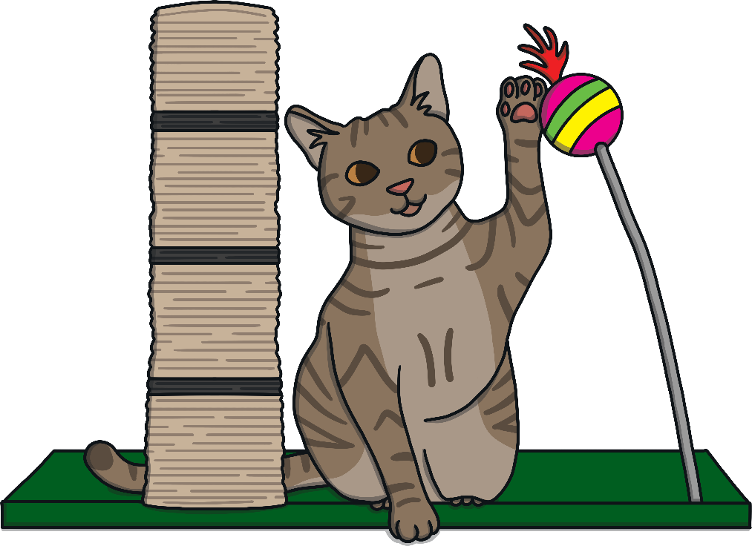
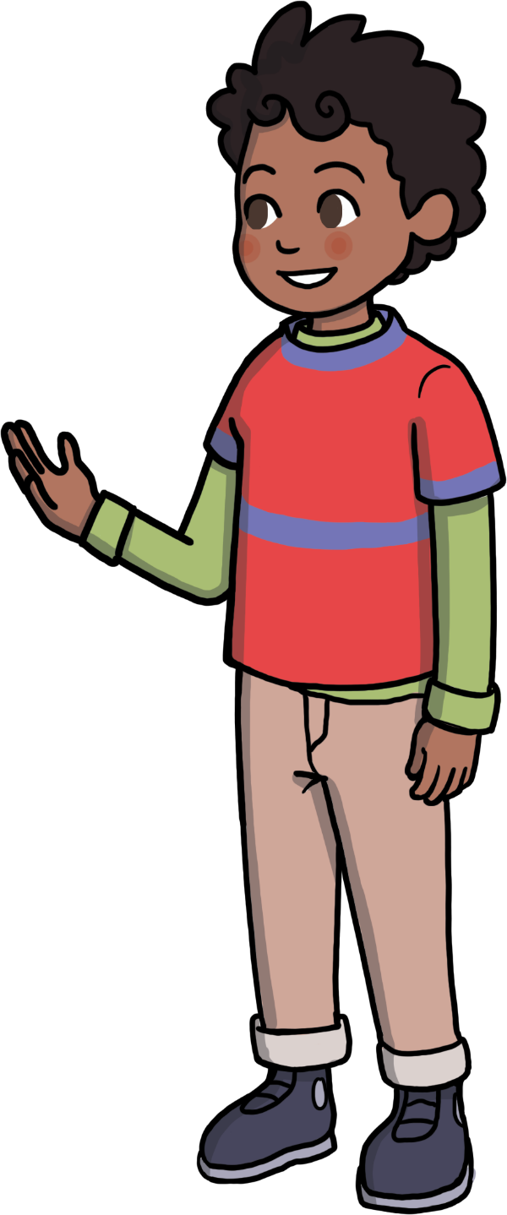

Suffixes: ness
“Yes, but Tiggy is a very playful cat”

Slide 9
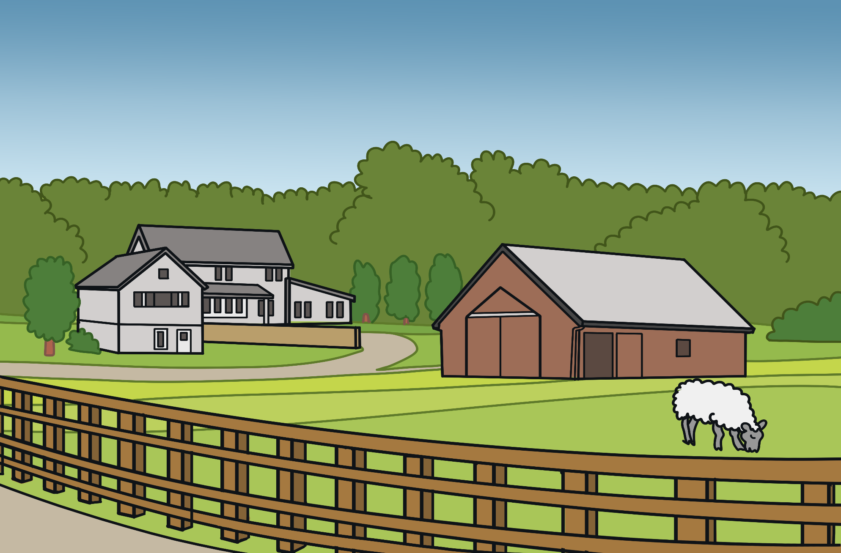
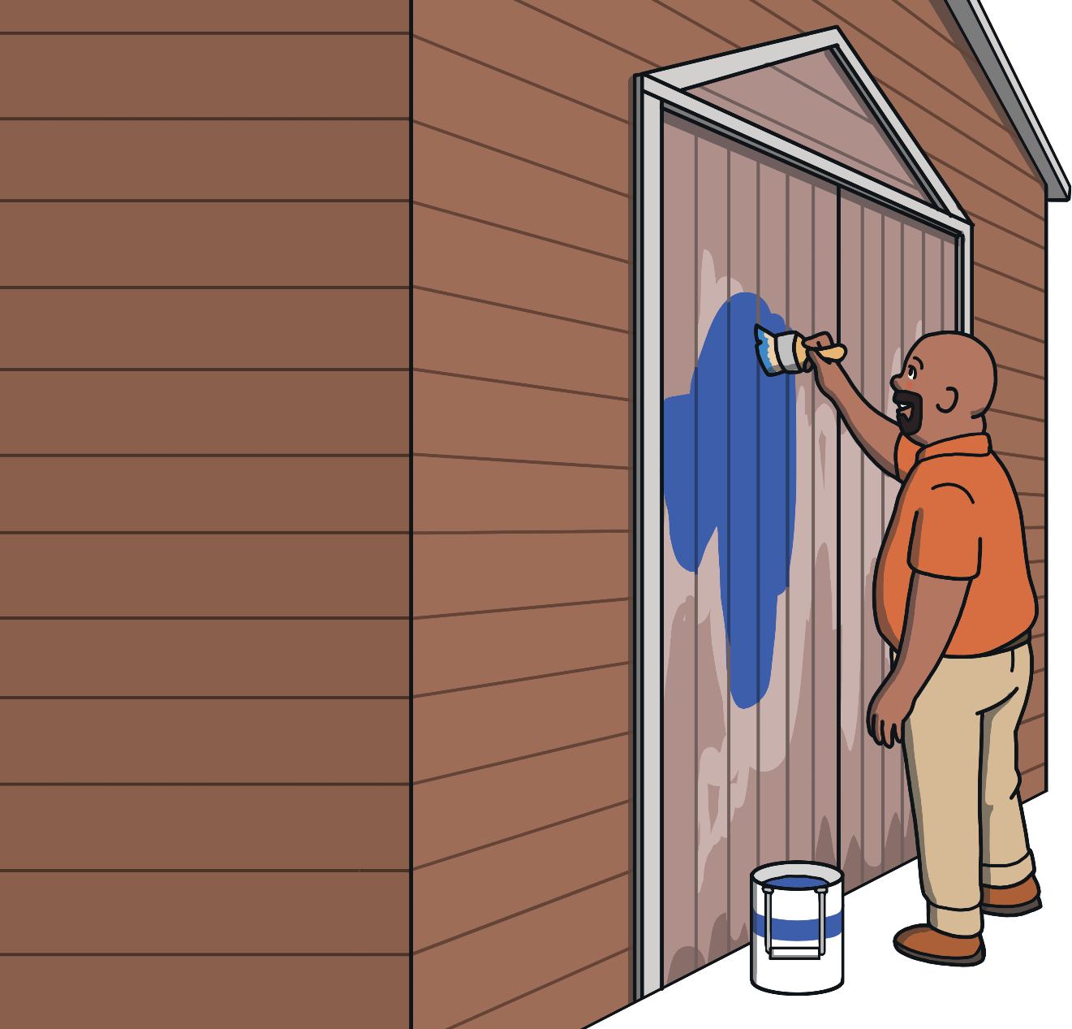
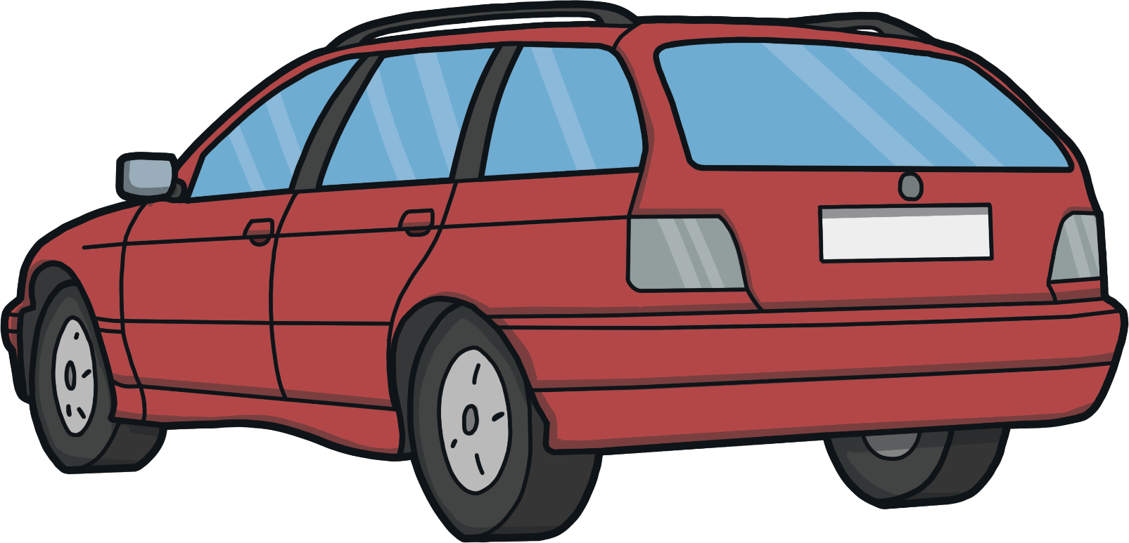
Uncle Lebo’s Farm
“It was so much fun on the farm, remember how we repainted the barn door?”
Yes…

Slide 10

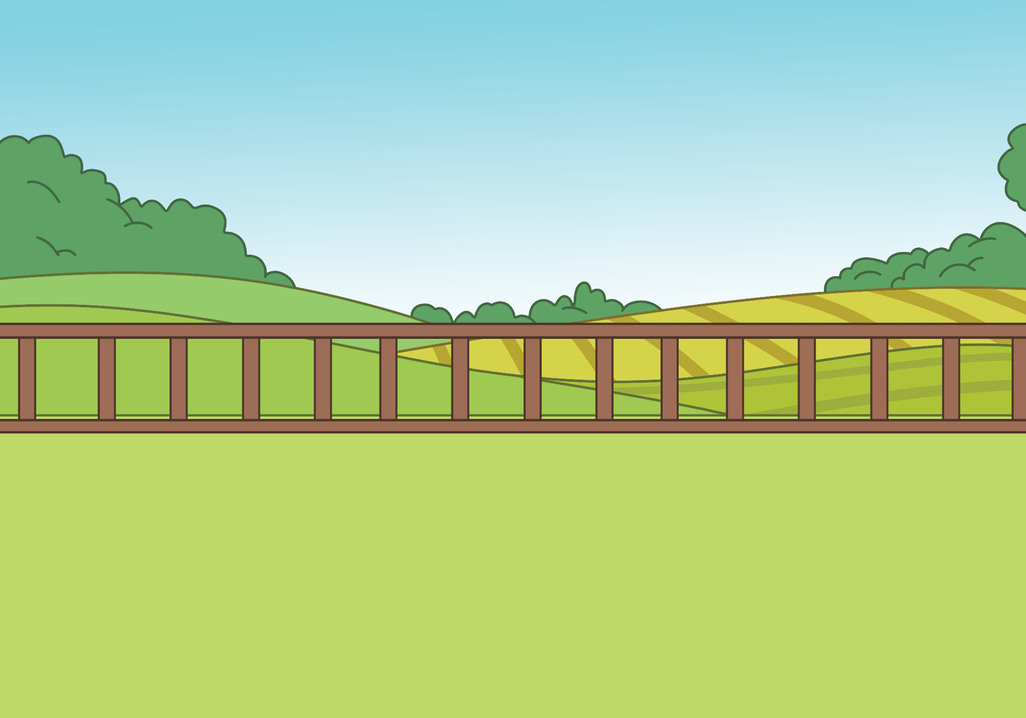
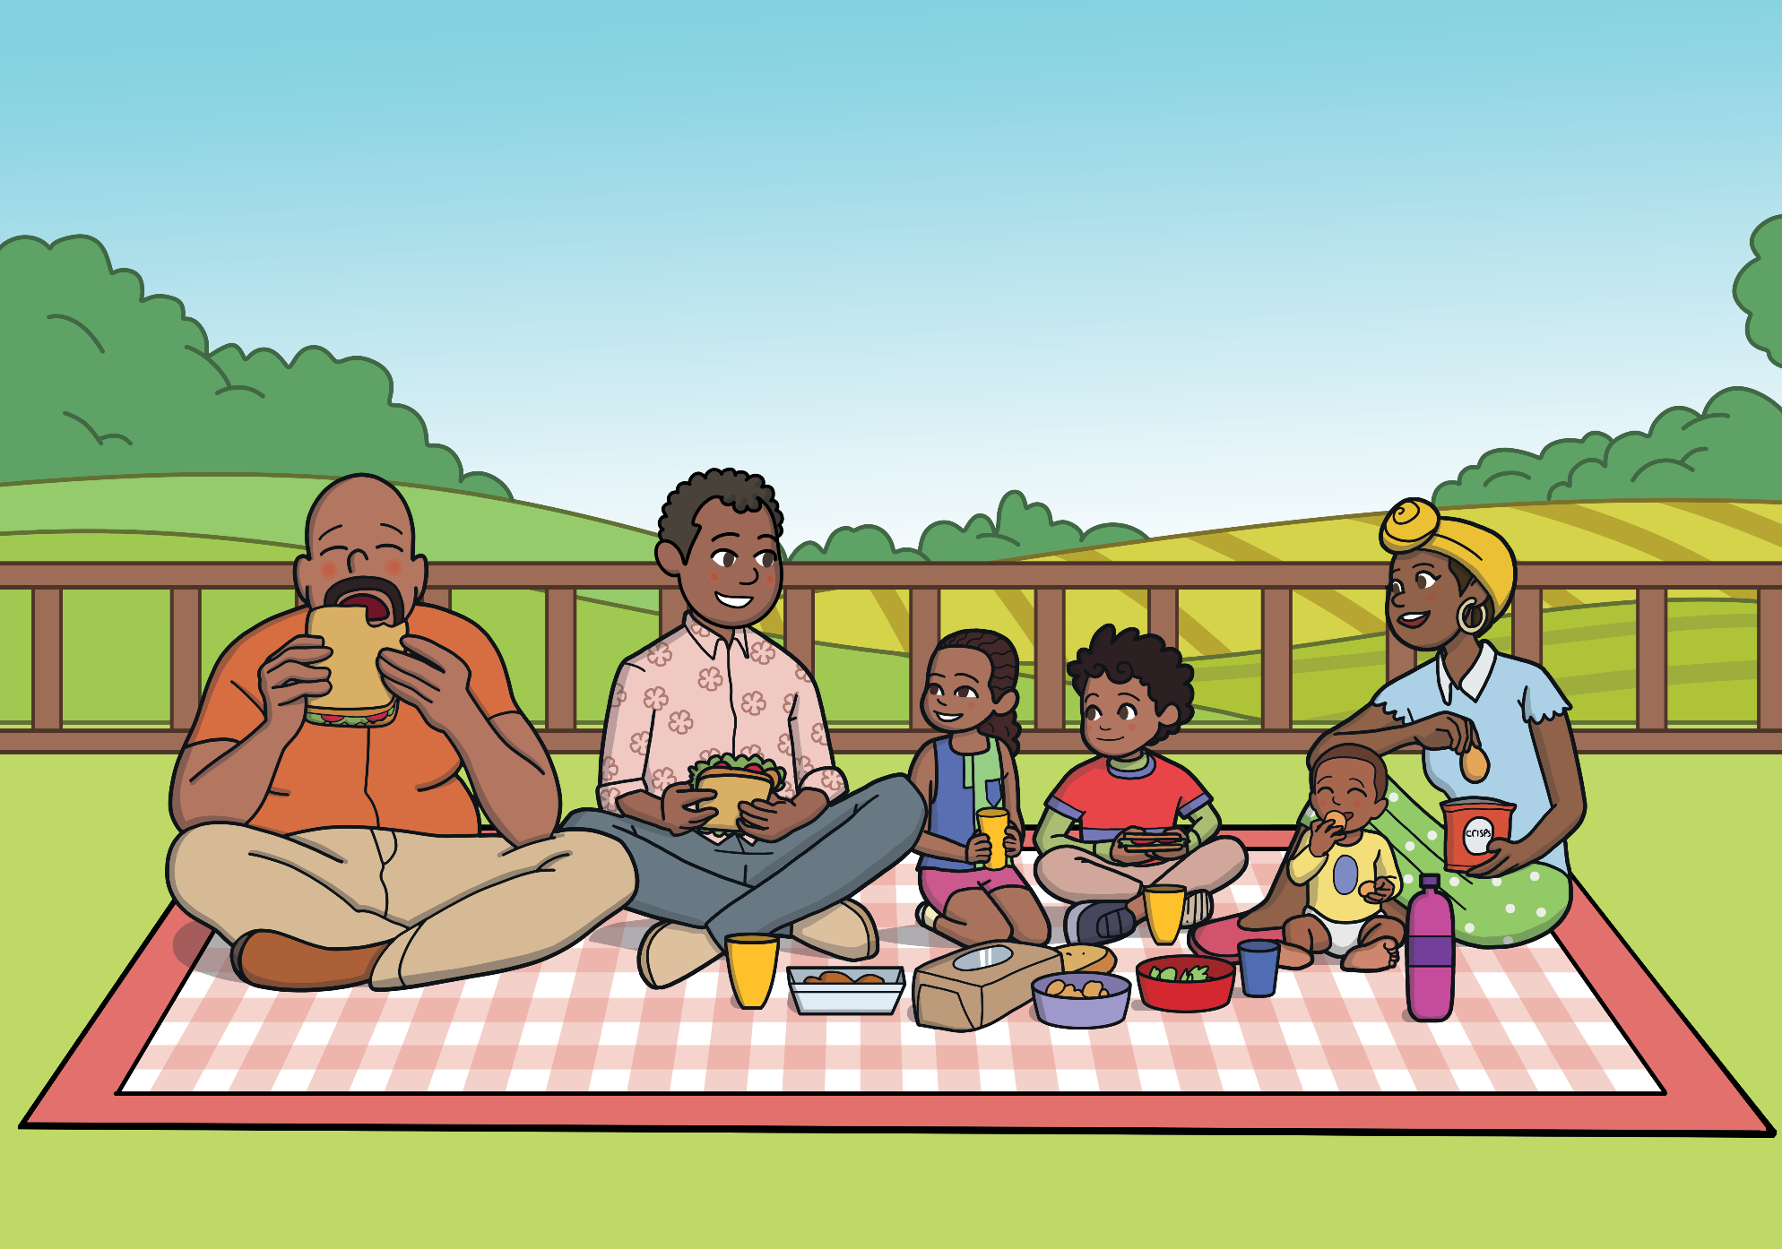

Uncle Lebo’s Farm
“I know bees give us honey, but where does sugar come from?”
“I am so thankful that we are able to visit you on the farm”
“It is such a wonderful day today”
“Look at that beautiful flower, with a helpful bee on it.”

Slide 11
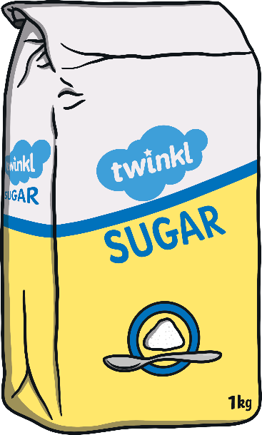
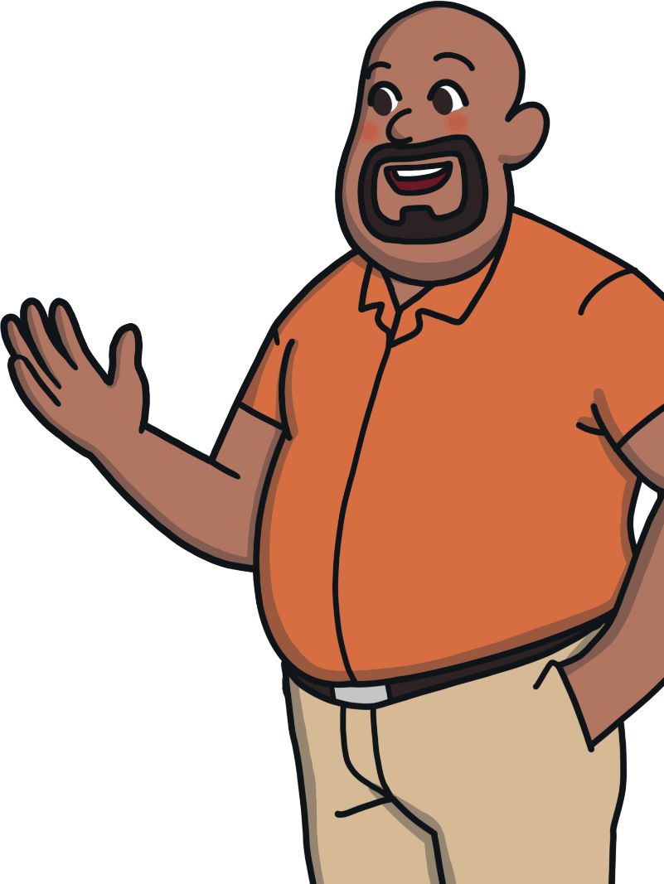

Uncle Lebo’s Farm
“Sugar comes from plants called sugarcane. They
grow in warmer areas especially KZN. The plants are
harvested with a special machine. They don’t cut the
whole plant down, and leave a shoot to grow again. The
plants are transported to a factory where they go
through the process of turning sugarcane into sugar.”

Slide 12

Uncle Lebo’s Farm
“You mean plants become sugar?”

Slide 13
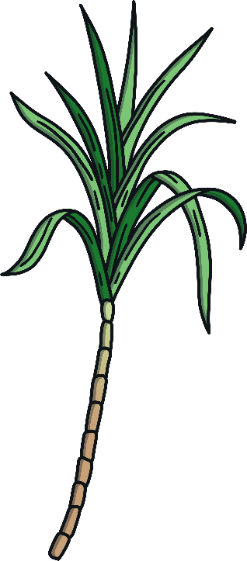

Uncle Lebo’s Farm
“Yes! It’s quite a process. The sugarcane gets washed, then crushed to extract the juice. The juice gets heated and spun in a centrifuge. Some sugar crystals are added so that the sugar can crystalize. These sugar crystals are dried and packaged and ready to use in Gogo’s tea.”
Let’s take a close look at the sugar cane process…

Slide 14



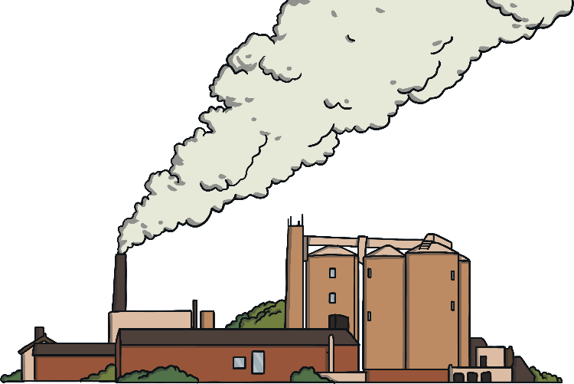
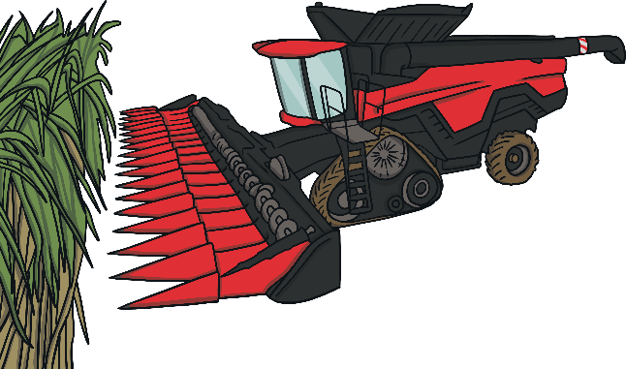



The Sugarcane Process
Afterwards, the sugar cane is processed in the factory.
Then, it’s harvested using a special machine.
Finally, the sugar is ready to be used.
First, the sugar cane is grown on the farm.
Click here for next slide

Slide 15

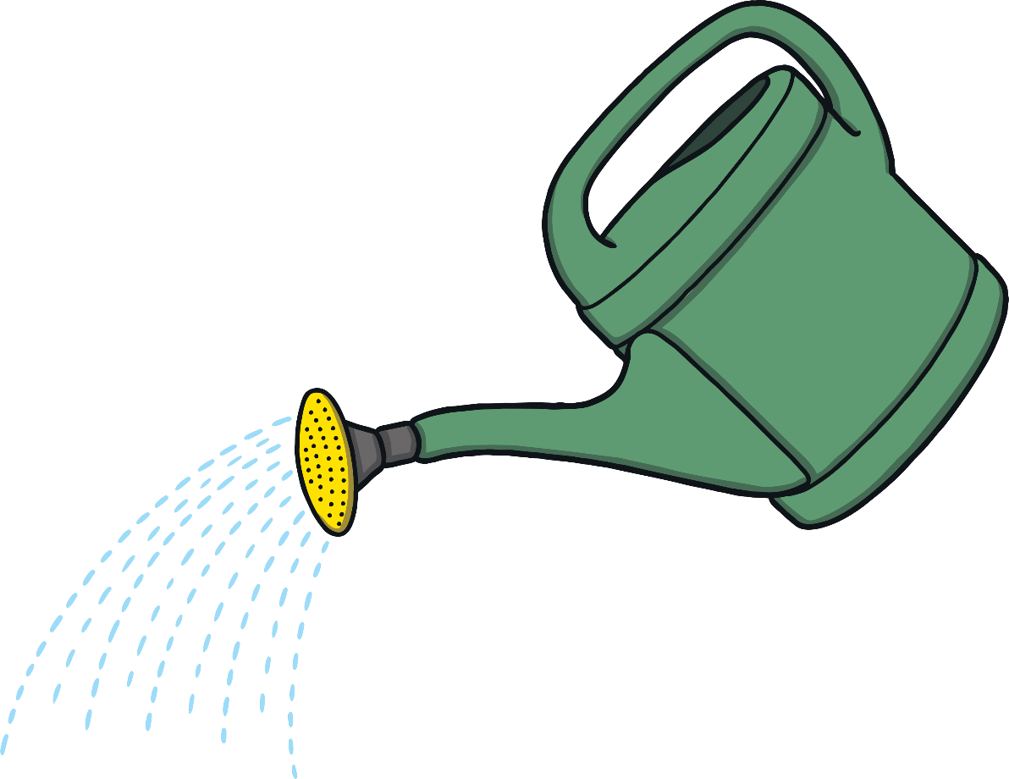



Let’s play a game!
Help Uncle Lebo grow his next crop!
Click on the word to water the Sugar cane and grow into a sprout.
Click on the suffix to add sunlight, and help the sugarcane grow even bigger!
Once the plant is fully grown, click on Uncle Lebo to Harvest the crop!
See how many you can do!
Ready, Steady, Go!
First, click the word to water the seed.
Now, Click the suffix to add some sunlight.
Great job! Let’s move onto the next crop. Click on the arrow to move on to the next word.
truth
ful
Good work! Now click on uncle Lebo so he can harvest the crop!
Next
Notes:
Teacher Suggestion: Click the brick to reveal the word, ask the children to read the word, and once the word has been read correctly, click the word to add the brick to the wall.

Slide 16


Let’s play a game!
Help Bongi and Nandi build the shed!
Click on the brick to reveal the word.
Read the word, then click on the word to place the brick onto the wall.
Ready, Steady, Go!
Well done!
grace
ful
Next
Notes:
Teacher Suggestion: Click the brick to reveal the word, ask the children to read the word, and once the word has been read correctly, click the word to add the brick to the wall.

Slide 17
Let’s play a game!
Help Bongi and Nandi build the shed!
Click on the brick to reveal the word.
Read the word, then click on the word to place the brick onto the wall.
Ready, Steady, Go!
Well done!
faith
ful
Next
Notes:
Teacher Suggestion: Click the brick to reveal the word, ask the children to read the word, and once the word has been read correctly, click the word to add the brick to the wall.

Slide 18
Let’s play a game!
Help Bongi and Nandi build the shed!
Click on the brick to reveal the word.
Read the word, then click on the word to place the brick onto the wall.
Ready, Steady, Go!
Well done!
hope
ful
Next
Notes:
Teacher Suggestion: Click the brick to reveal the word, ask the children to read the word, and once the word has been read correctly, click the word to add the brick to the wall.

Slide 19
Let’s play a game!
Help Bongi and Nandi build the shed!
Click on the brick to reveal the word.
Read the word, then click on the word to place the brick onto the wall.
Ready, Steady, Go!
Well done!
Well done!
pain
ful
Notes:
Teacher Suggestion: Click the brick to reveal the word, ask the children to read the word, and once the word has been read correctly, click the word to add the brick to the wall.

Slide 20

Uncle Lebo’s Farm
“At the factory, the plants are crushed and the juice is extracted. It then goes through a special processes called clarification, evaporation and crystallisation”

Slide 21
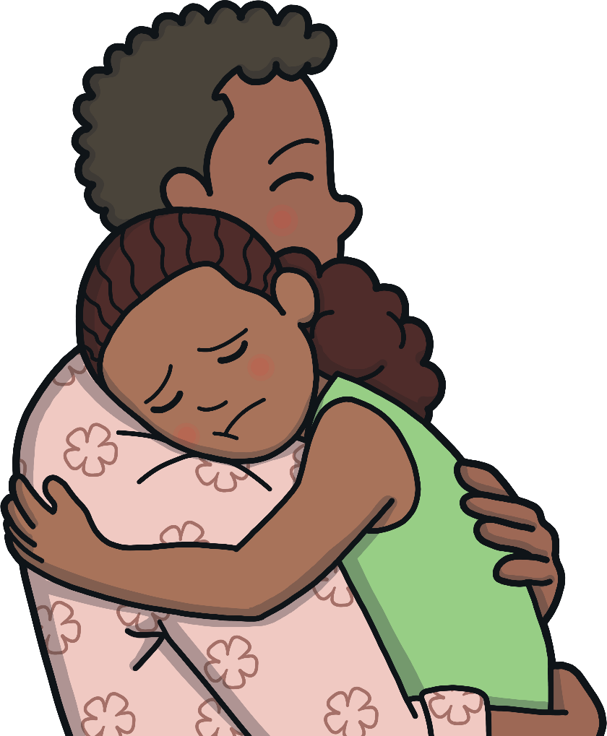

Uncle Lebo’s Farm
Dad gives a tearful Nandi a careful hug.
“To be truthful, I don’t understand any of those big words”

Slide 22

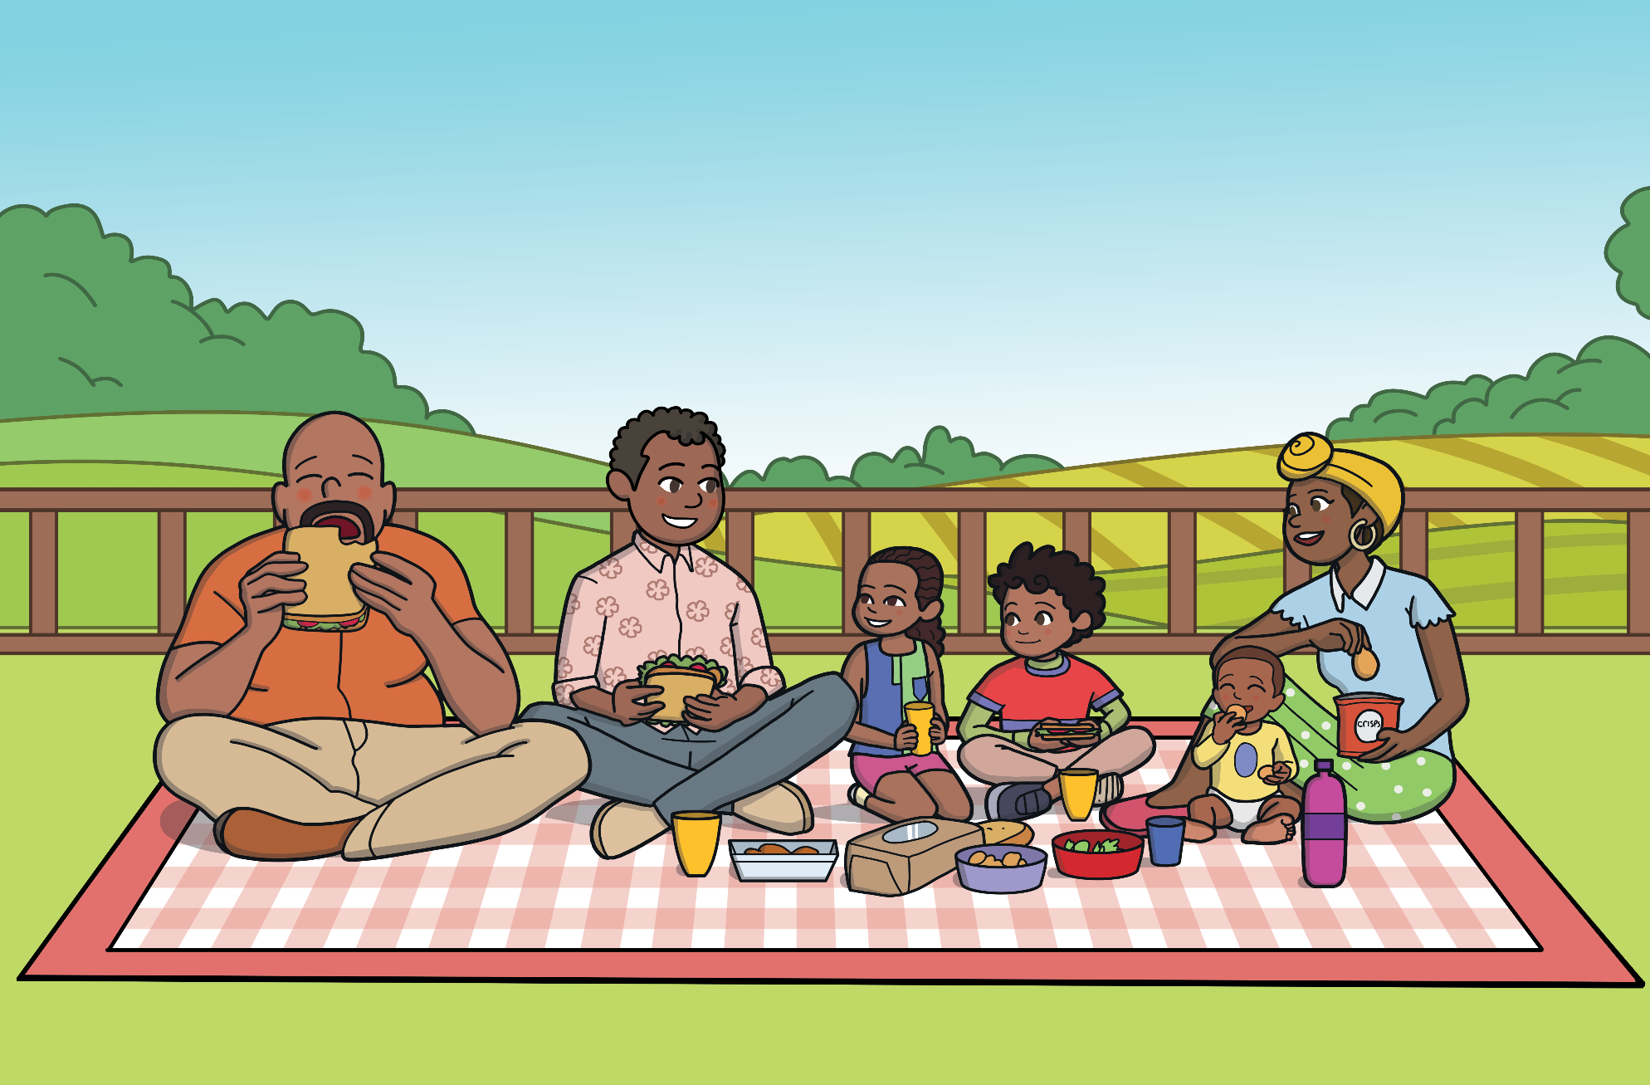
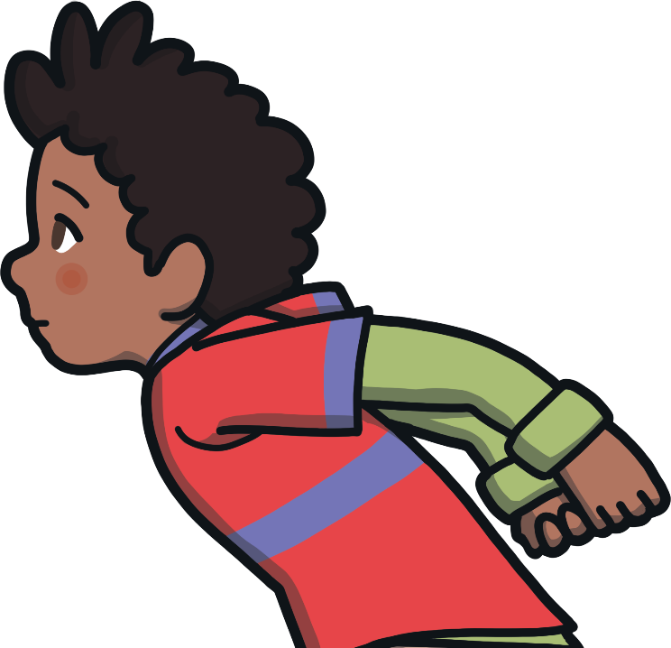

Uncle Lebo’s Farm
“Be joyful Nandi!”
“You don’t have to understand all those big words just yet.”
Let’s go and play!

Slide 23


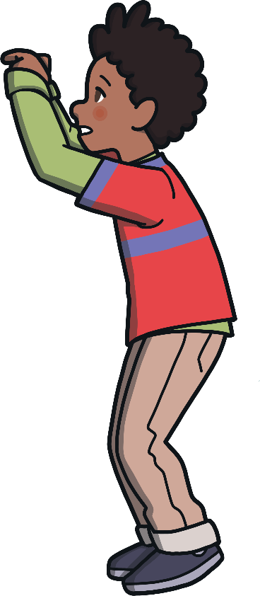
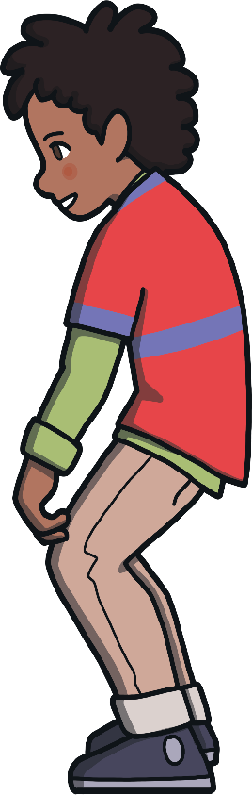
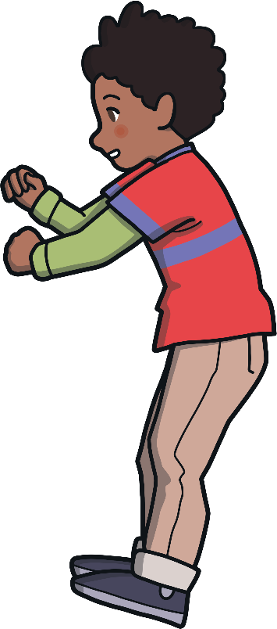



Let’s play a game!
Help the children cross the stones!
Click on the rock to reveal the word
Read the word with your teacher, if you get it right, click the word to help the children jump to the next rock!
See how many words you can get right!
Ready, Steady, Go!
The playful children run around on the grass, jumping on stones.
Next
pain
painful

Slide 24
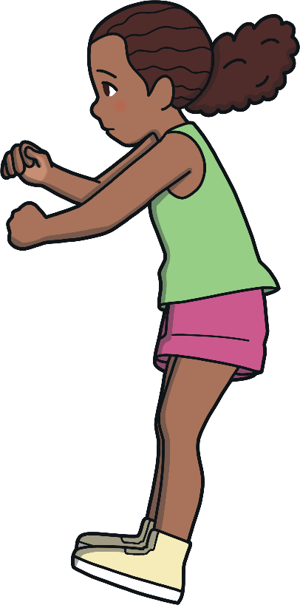


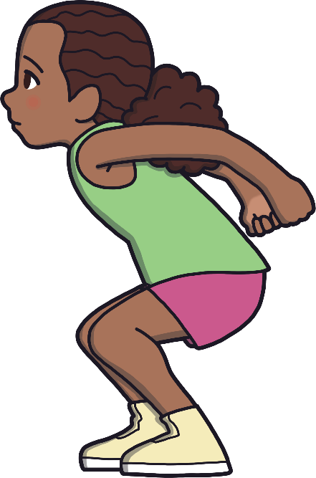
Let’s play a game!
Next
delight
delightful

Slide 25
Let’s play a game!
Help the children cross the stones!
Click on the rock to reveal the word
Read the word with your teacher, if you get it right, click the word to help the children jump to the next rock!
See how many words you can get right!
Ready, Steady, Go!
The playful children run around on the grass, jumping on stones.
Next
tear
tearful

Slide 26



Let’s play a game!
Well done!
care
careful

Slide 27
Suffixes
Read the words as they appear on the screen
+
=
+
=
+
=
+
+
+
+
=
=
=
+
=
+
=
+
=
+
=
+
=
+
=
=
helpful
hurtful
truthful
playful
wonderful
faithful
delightful
hopeful
help
ful
thankful
hurt
ful
joyful
truth
ful
tearful
careful
wonder
graceful
delight
play
faith
ful
ful
ful
hope
ful
thank
ful
joy
ful
tear
ful
care
ful
grace
ful
ful
-ful

Slide 28
Suffixes
This is English, so there’s always an exception.
If the root word ends in a ‘y’, the ‘y’ changes to an ‘i’ and then you add the suffix.
Such as in beauty. Beauty becomes beautiful.
beaut
i
ful

