Slide 1
2D Shape:
Parallel and Perpendicular Lines
N
- MATHS TOPICS KS2 -

Slide 2


Lines
What are parallel lines?
They are two lines on a surface that never meet. They are always the same distance apart.
2D Shape

Slide 3
Lines
What is a perpendicular line?
This is when a line is at exactly 90 degrees (a right angle!) to another line.
90 degrees!
2D Shape

Slide 4
Lines
Helpful videos
Watch these videos before you complete your work.
https://www.bbc.co.uk/bitesize/topics/zb84382/articles/zp327hv
https://youtu.be/dSE2lTU1sAc
2D Shape

Slide 5
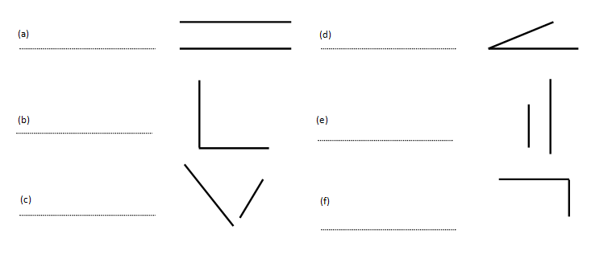
Lines
Quick task 1
Which of these shapes are parallel, perpendicular or neither?
2D Shape

Slide 6

Lines
Quick task 2
Tick the two shapes that have perpendicular lines:
2D Shape

