Slide 1
2D Shape:
Types of Triangle
N
- MATHS TOPICS KS2 -

Slide 2
Types of Triangle
What is a triangle?
A 2D shape;
3 straight sides;
3 angles.
2D Shape

Slide 3
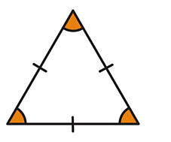
Types of Triangle
There are four main types of triangle.
1.
Equilateral
Equilateral triangles have three equal sides and three equal angles of 60°.
This is easy to remember because 'equilateral' sounds like 'equal'!
2D Shape

Slide 4
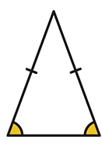
Types of Triangle
There are four main types of triangle.
2.
Isosceles
Isosceles triangles have two equal sides and two equal angles.
2D Shape

Slide 5
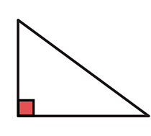
Types of Triangle
There are four main types of triangle.
3.
Right-angled
You can always spot a right-angled triangle because it has a right angle (90°).
The right-angle is usually marked by a small square in the corner.
2D Shape

Slide 6
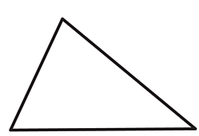
Types of Triangle
There are four main types of triangle.
4.
Scalene
Scalene triangles have no equal sides and no equal angles.
Its sides and angles are all different sizes.
2D Shape

Slide 7
Types of Triangle
Helpful videos
Watch both of these videos before you complete your work.
https://www.bbc.co.uk/bitesize/topics/zb84382/articles/zggsfrd
https://youtu.be/i95n30i0Oq8
2D Shape

Slide 8
Properties of Triangles
Types of Triangles
Equilateral Triangle
Isosceles triangle
Scalene triangle
3 equal sides
3 equal angles.
2 equal sides
2 equal angles (base)
3 unequal sides
3 unequal angles

Slide 9
Any triangle containing a 90º angle is a right-angled triangle
An isosceles or a scalene triangle may contain a right angle.
Right-angled
isosceles triangles.
Right-angled
scalene triangle.

